Slide 1
자료구조 및 알고리즘 - Algorithm Design Techniques
Minyoung Sung
Dept. of Mechanical & Information Engineering,
University of Seoul

Slide 2
Contents
Euler Circuits
NP-Completeness
Greedy Algorithms
Scheduling problem
Huffman codes
Bin packing
Divide and Conquer
Closest-points problem
Arithmetic problems
Randomized Algorithms
Random-number generators
Skip lists
Backtracking Algorithms
Turnpike reconstruction problem

Slide 3
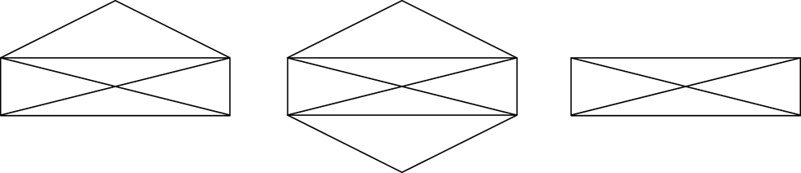
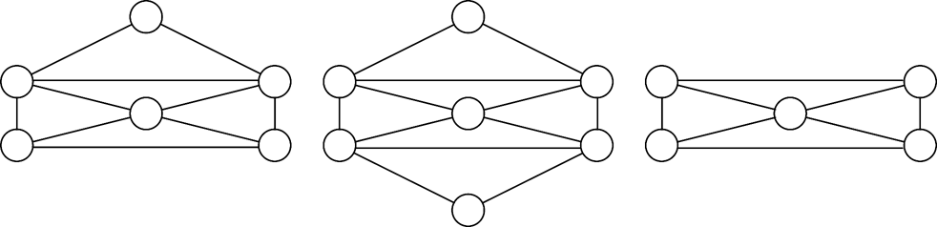
Euler Circuits
“Euler path (tour)”: find a path that visits every edge exactly once.
“Euler circuit”: find a cycle that visits every edge exactly once.
An Euler circuit is possible only if the graph is connected and each vertex has an even degree.
If exactly two vertices have odd degree, an Euler tour is still possible if we start at one of the odd-degree vertices.
Euler path exists
Euler path nor circuit exists
Euler circuit exists

Slide 4
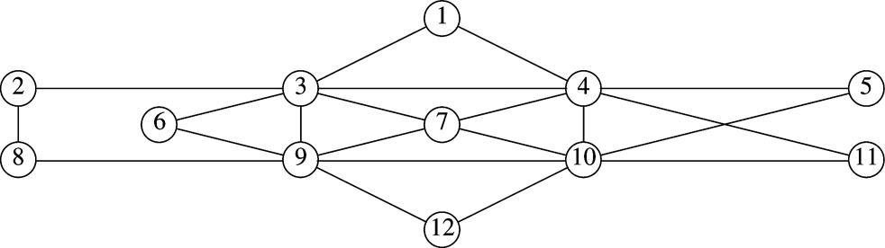
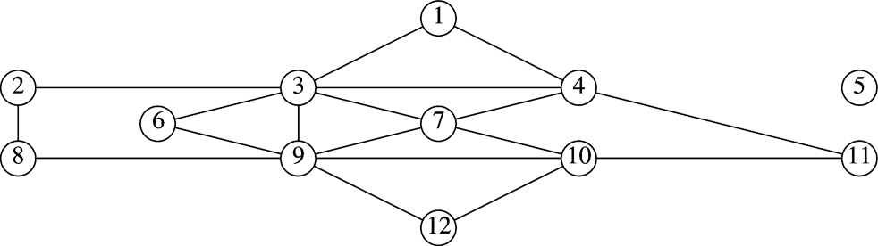
Euler Circuits
Euler circuit algorithm
Basically perform a depth-first search.
We might visit a portion of the graph and return to the starting point prematurely → find the first vertex on the path that has an untraversed edge and perform another DFS.
Graph remaining after 5, 4, 10, 5

Slide 5
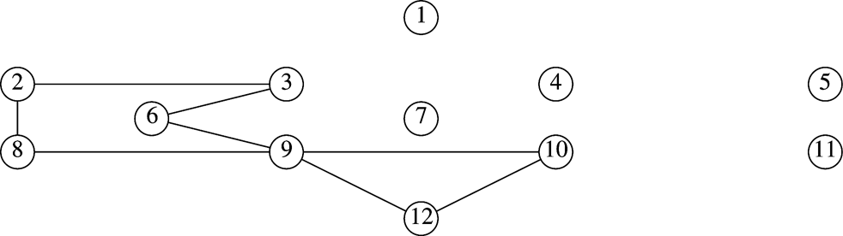
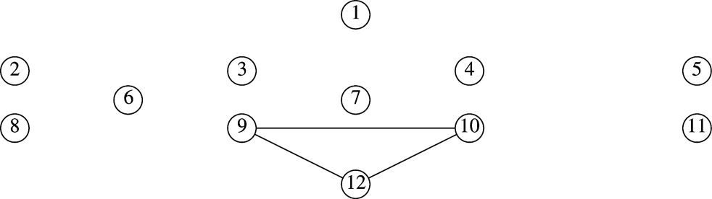
Euler Circuits
Running time is O(|E|+|V|).
Hamiltonian cycle problem:
Find a simple cycle in an undirected graph that visits every vertex
No efficient algorithm is known!
Graph remaining after 5, 4, 1, 3, 7, 4, 11, 10, 7, 9, 3, 4, 10, 5
Graph remaining after 5, 4, 1, 3, 2, 8, 9, 6, 3, 7, 4, 11, 10, 7, 9, 3, 4, 10, 5

Slide 6
Introduction to NP-Completeness
Easy vs. Hard
We cannot expect better than linear running time.
The gcd algorithm on M and N takes O(logN). Since the number is log M and log N bits, gcd is really taking time linear in the size of input.
Undecidable problems are the other extreme: “impossible problems”
Halting problem:
“Is it possible to have your C compiler have a feature that detects all infinite loops?”
If yes, we could produce a program called LOOP. LOOP takes as input a program, P, and runs P on itself. It prints YES if P loops. If P terminates, LOOP goes into an infinite loop.
What if LOOP is given itself as input?
→ Contradiction! Program LOOP cannot possibly exist.

Slide 7
Introduction to NP-Completeness
The class NP lies a few steps down from the undecidable problems.
Nondeterministic polynomial-time.
A deterministic machine goes to next instruction that is unique. A nondeterministic machine has a choice of next steps and it will always choose the correct one if one of the steps leads to a solution.
A problem is in NP if, in polynomial time, we can prove that any “yes” instance is correct.
The Hamiltonian cycle problem is NP since, given a “yes” instance, it is a simple matter to check that it is really a Hamiltonian cycle.
The class NP includes all problems that have polynomial-time solutions.
Not all decidable problems are in NP.
Determining whether a graph does not have a Hamiltonian cycle. → one must enumerate all the cycles and check them. Thus it is not known to be in NP.

Slide 8
Introduction to NP-Completeness
Among the problems known to be in NP, there is a subset, NP-complete, which contains the hardest.
Any problem in NP can be polynomially reduced to a NP-complete.
Thus, if any NP-complete problem has a polynomial-time solution, every problem in NP must have a polynomial-time solution.
Hamiltonian cycle problem is NP-complete.
Traveling salesman problem: Given a complete graph, G=(V,E), with edge costs, is there a simple cycle that visits all vertices and has total cost ≤ K ?
TS problem is NP-complete:
It is in NP because a solution can be checked in polynomial time.

Slide 9
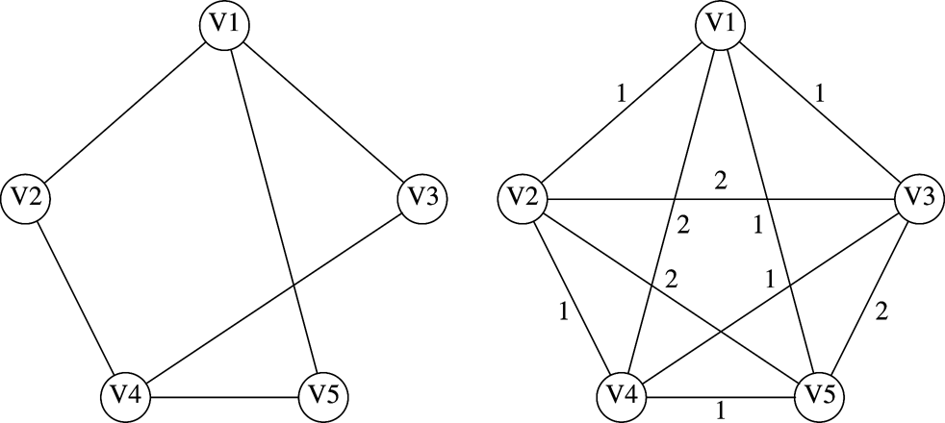
Introduction to NP-Completeness
TS problem is NP-complete:
TS problem is NP-complete because we can polynomially reduce the Hamiltonian cycle problem to TS problem: Construct a new graph G’. if and 2 otherwise. G has a HC iff G’ has a TS tour of K = |V|.
Many other well-known NP-complete problems
bin packing, knapsack, graph coloring, and clique
Hamiltonian cycle problem transformed to traveling salesman problem

Slide 10
Greedy Algorithms
In each phase, a decision is made that appears to be good (local optimum), without regard for future consequences.
Ex: Dijkstra’s, Prim’s, and Kruskal’s algorithms
If the absolute best answer is not required, simple greedy algorithm are sometimes used to produce approximate answers.
Making locally optimal choices does not always work.
Rush hour times in Miami: it is best to stay off the prime streets. It is better in some cases to make a temporary detour in the opposite direction.
We will look at several applications that uses greedy algorithms
Scheduling problem, Huffman codes, Bin packing

Slide 11
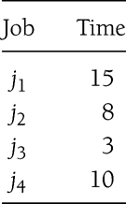
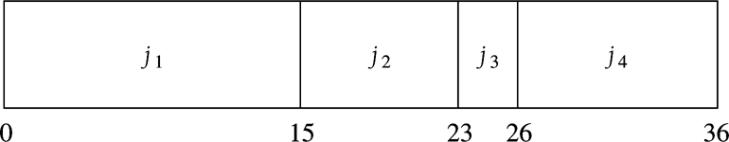
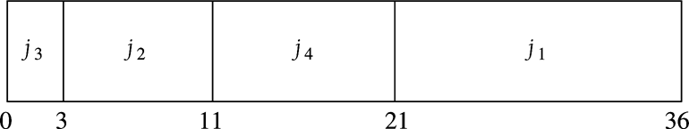
A Simple Scheduling Problem
Given jobs j₁, j₂, …, j_{N} with running times t₁, t₂, …, t_{N}, what is the best schedule to minimize the average completion time? (nonpreemptive)
Scheduling examples:
Shortest-job-first will always yield an optimal schedule:
Total cost C:
The first term is independent of ordering.
The optimum is to arrange by smallest running time first.
Average compl. times:
(15 + 23 + 26 +36) / 4
= 25
(3 + 11 + 21 + 36) / 4
= 17.75
Jobs in the schedule:
Jobs finishes at

Slide 12
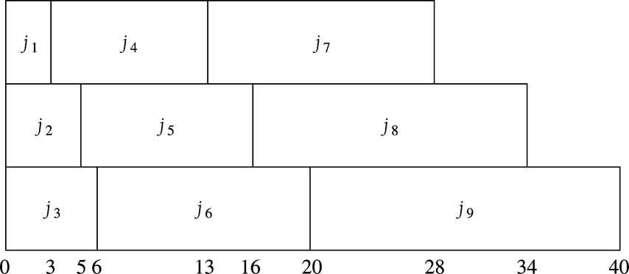
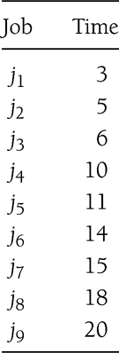
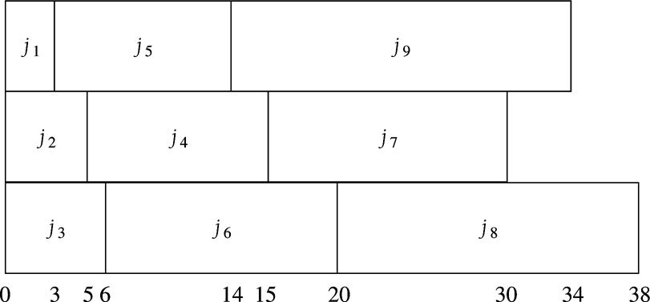
A Simple Scheduling Problem
Multiprocessor case: start jobs in the shortest first order, cycling through processors.
An optimal solution: 165/9
A second optimal solution: 165/9

Slide 13
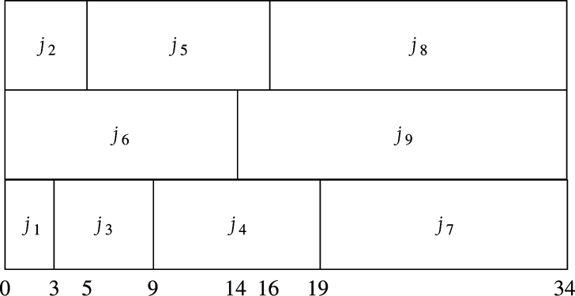
A Simple Scheduling Problem
Minimizing the final completion is much harder and turns out to be NP-complete
Another way of phrasing the knapsack or bin packing problems.
Minimizing the final completion time

Slide 14
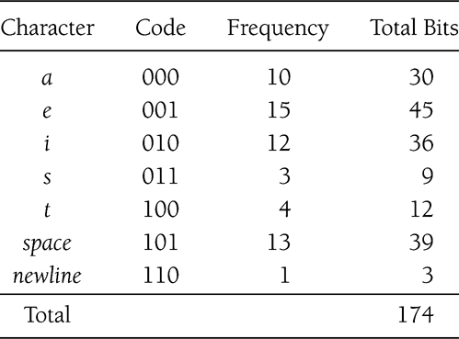
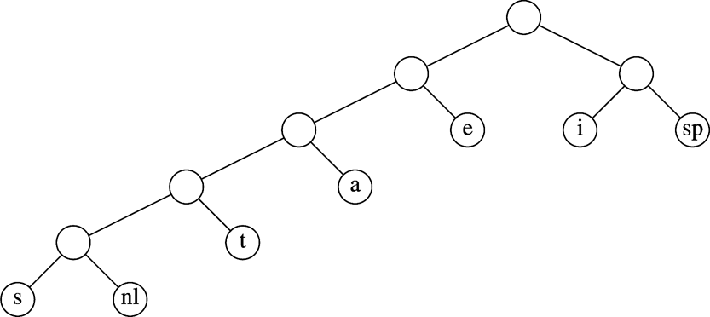
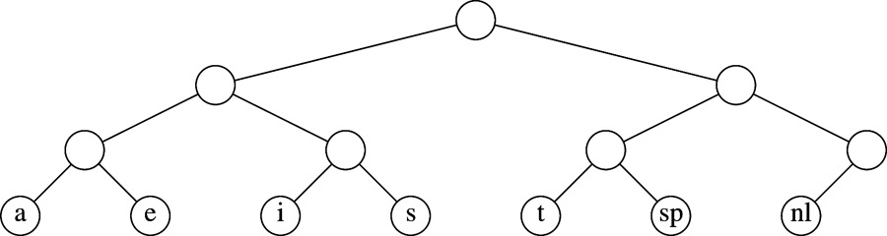
Huffman Codes
If the size of a character set is C, bits are needed for encoding.
7 characters (a, e, i, s, t, space, newline) : 3 bits
a file with 58 characters : 174 bits required.
Binary code can be represented by the binary tree.
If character c_{i} is at depth d_{i} and occurs f_{i} times, the cost is equal to
Prefix code
If the characters are placed only at the leaves, any sequence of bits can be always decoded unambiguously.
Optimal prefix code. Uses 146 bits
Original code in a tree

Slide 15
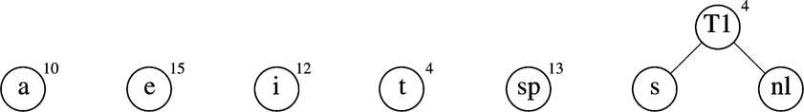
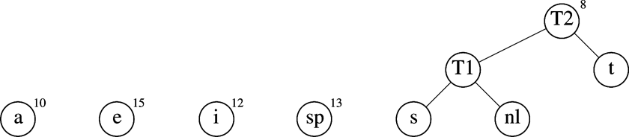
Huffman Codes
Huffman’s Algorithm
Maintain a forest of tree.
The weight of a tree is equal to the sum of the frequencies of leaves.
Select the two trees T1 and T2 of smallest weight and form a new tree.
Initial stage
After the 1st merge
After the 2nd merge

Slide 16
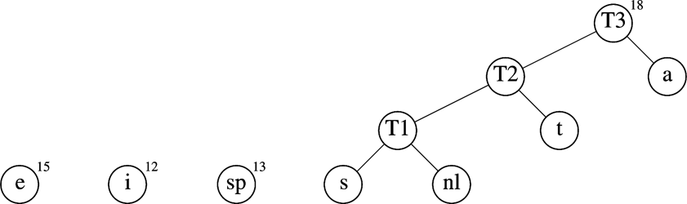
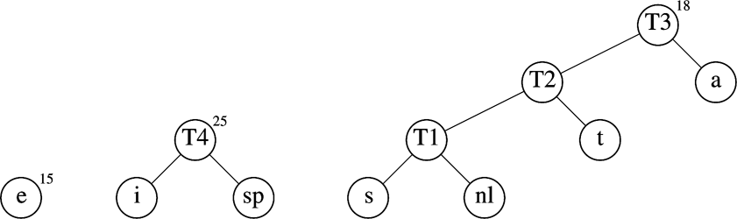
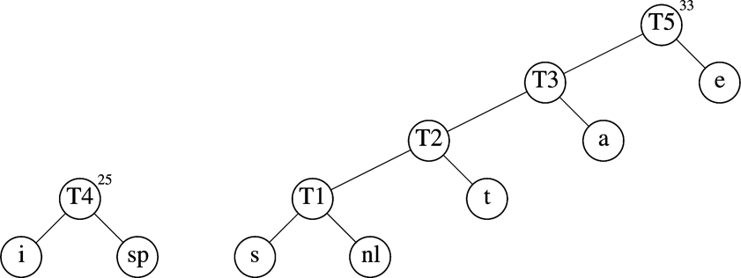
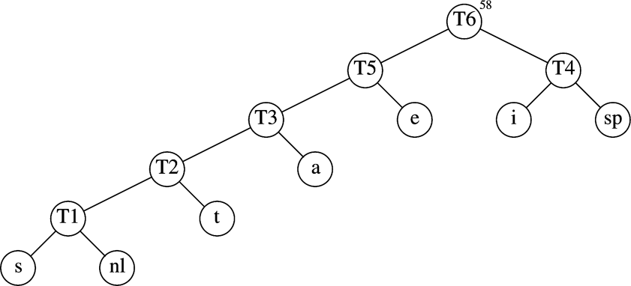
Huffman Codes
With C characters, the running time is O( ) using priority queue.
One buildHeap, deleteMin, and inserts.
Practical consideration
The encoding information must be transmitted at the start of the compressed file.
After the 3rd merge
After the 4th merge
After the 5th merge
After final merge

Slide 17
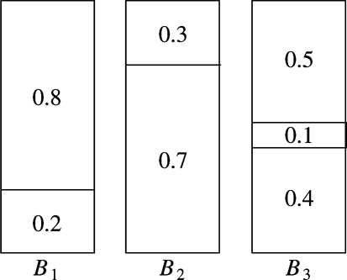
Approximate Bin Packing
Bin-packing problem
Given N items of sizes s₁, s₂, …, s_{N}, ( ), pack the items in the fewest number of bins (each bin has unit capacity).
Online bin packing: each item must be placed before the next one.
Offline bin packing: no need to do anything until all input is read.
There is no optimal algorithm for online bin packing.
Theorem: There are inputs that force any online bin packing algorithm to use at least 4/3 the optimal number of bins.
There are simple algorithms that guarantee that # bins used is less than twice optimal.
Optimal packing for 0.2, 0.5, 0.4, 0.7, 0.1., 0.3, 0.8

Slide 18
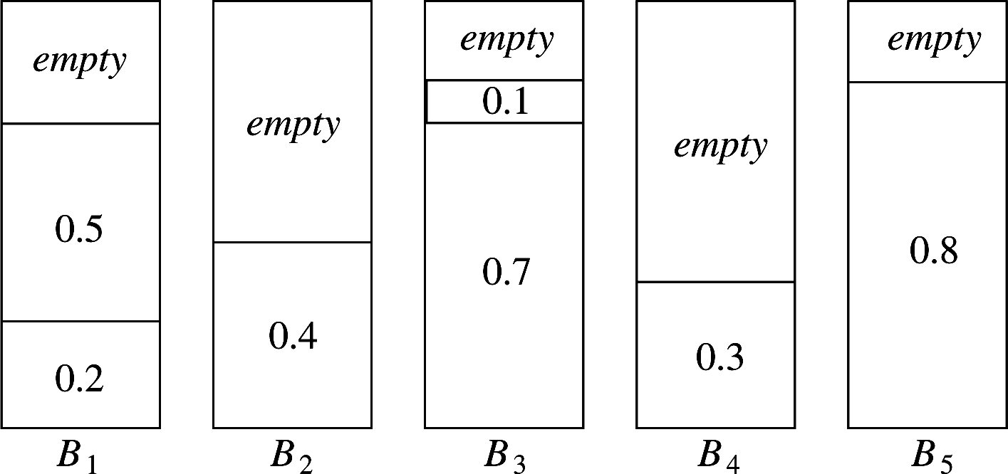
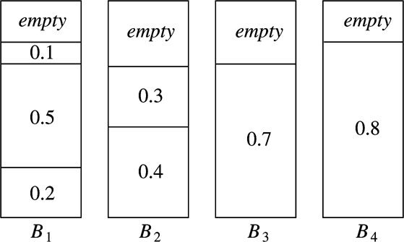
Approximate Bin Packing
Next Fit
See whether an item fits in the same bin as the last item. If so, place there; otherwise a new bin is created.
Theorem: Let M be the optimal number of bins required to pack a list of items. Then NF never uses more than 2M bins.
First Fit
Scan the bins in order and place the new item in the first bin that is large enough to hold it. Create a new bin in case of no alternative.
Next fit for 0.2, 0.5, 0.4, 0.7, 0.1., 0.3, 0.8
First fit for 0.2, 0.5, 0.4, 0.7, 0.1., 0.3, 0.8

Slide 19
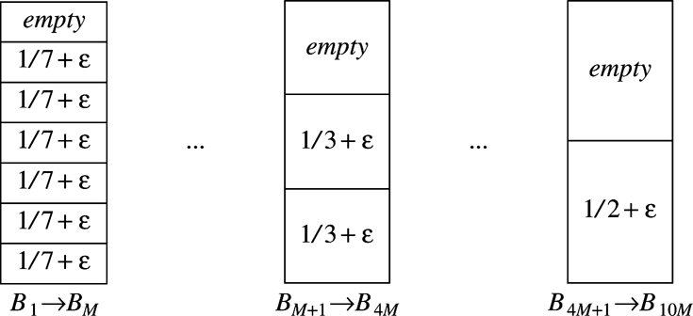
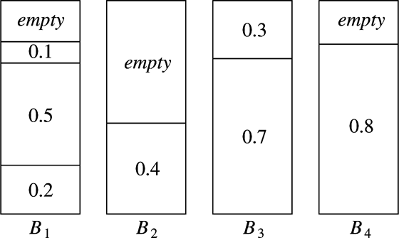
Approximate Bin Packing
First Fit
O(N²) running time.
Theorem: Let M be the optimal number of bins required to pack a list of items. FF never uses more than 17M/10 + 7/10 bins.
Empirical results show that FF uses roughly 2 percent more bins than optimal. Quite acceptable.
Best Fit
Each item is placed in the tightest spot among all bins.
A case where FF uses 10M bins instead of 6M
Best fit for 0.2, 0.5, 0.4, 0.7, 0.1., 0.3, 0.8

Slide 20
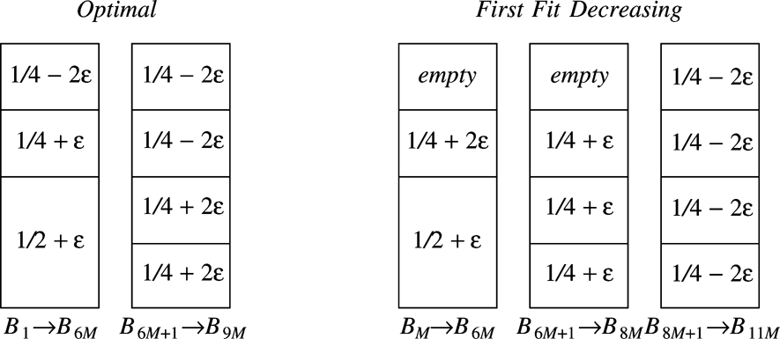
Approximate Bin Packing
Offline algorithm
Sort the items, placing the largest items first.
Then, apply first fit or best fit – first fit decreasing or best fit decreasing.
Theorem: Let M be the optimal number of bins required. Then FF decreasing never uses more than 11M/9 + 6/9 bins.
Example where FF decreasing uses 11k+8 bins, but only 9k+6 bins are required

Slide 21
Divide and Conquer
Divide-and-conquer algorithm:
Routine contains at least two recursive calls.
Subproblems need to be disjoint. Cf. Fibonacci
Ex: maximum subsequence sum, mergesort, quicksort
Algorithms that perform only one recursive call are not div-and-conquer.
Search for binary search tree, Dijkstra’s shortest path, depth-first search
Theorem: The solution to the equation , is
Ex) mergesort has a=b=2 and k=1, giving answer O(NlogN).
We will see more examples of div-and-conquer:
closest-points problem and matrix multiplication

Slide 22
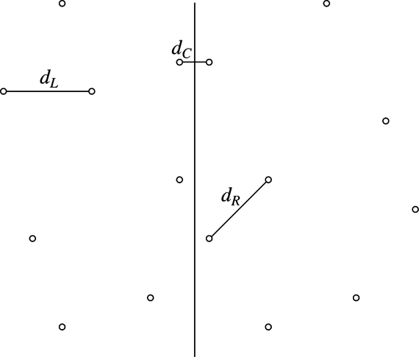
Closest-Points Problem
With a list P of points in a plane as input, we are required to find the closest pair of points.
Checking all pairs of distance gives O( ).
O(NlogN) solution
Sort points by x coordinate
Partition the set into two halves: P_{L} and P_{R}.
The closest points may be both in P_{L}, or both in P_{R}, or one in P_{L} and the other in P_{R}. – call the distances d_{L}, d_{R}, and d_{C}.
We can compute d_{L} and d_{R} recursively. We must be able to compute d_{C} in O(N)

Slide 23
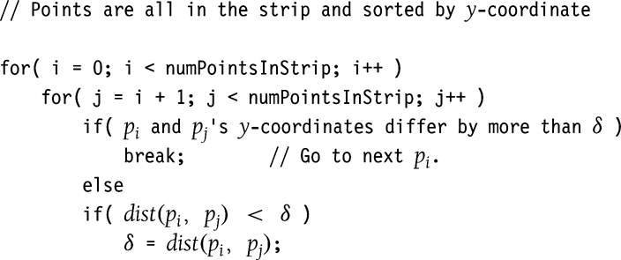
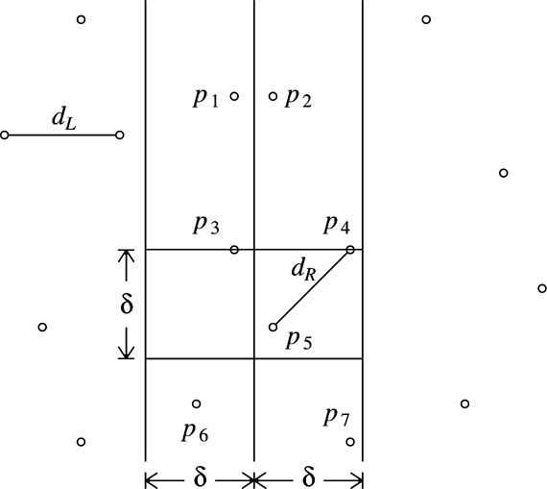
Closest-Points Problem
Let δ=min(d_{L}, d_{R}). We only need to compute d_{C} if d_{C} improves on δ.
If d_{C} is such a distance, the two points defining d_{C} must be within δ of the dividing line. Refer to this area as a strip.
The y coordinates of the two points defining d_{C} can differ by at most δ. Suppose points are sorted by their y coordinates.
Only p4 and p5 are considered in the second for loop

Slide 24
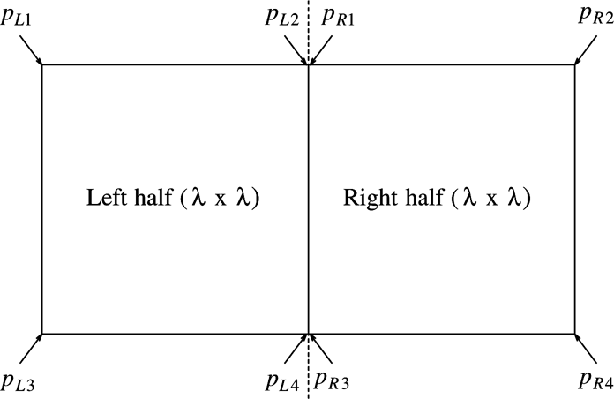
Closest-Points Problem
In the worst case, for any point p_{i}, at most 7 points p_{j} are considered.
These points must lie either in the δ-by-δ square in the left half of the strip or in the δ-by-δ square in the right half.
One of these points is p_{i}. At most seven points to be considered.
Even though p_{L2} and p_{R1} have the same coordinates, they could be different.
Because at most 7 points are considered for each p_{i}, the time to compute d_{C} that is better than δ is O(N).
At most eight points fits in the rectangle.

Slide 25
Arithmetic Problems
Multiplying Integers
Multiplying two N-digit numbers, X and Y requires operations.
If X = 61,438,521 and Y = 94,736,407, break X and Y into two halves.
X_{L} = 6,143, X_{R} = 8,521, Y_{L} = 9,473, Y_{R} = 6,407 XY = X_{L}Y_{L} 10⁸ + (X_{L}Y_{R} + X_{R}Y_{L})10⁴ + X_{R}Y_{R}
→ No improvement..
X_{L}Y_{R} + X_{R}Y_{L} = (X_{L} – X_{R})(Y_{R} – Y_{L}) + X_{L}Y_{L} + X_{R}Y_{R}
Use one multiplication, plus the result of two multiplications that have already been performed.
→
Be careful, for small N the overhead is significant
For larger N there are even better algorithms. They also make extensive use of divide and conquer.

Slide 26
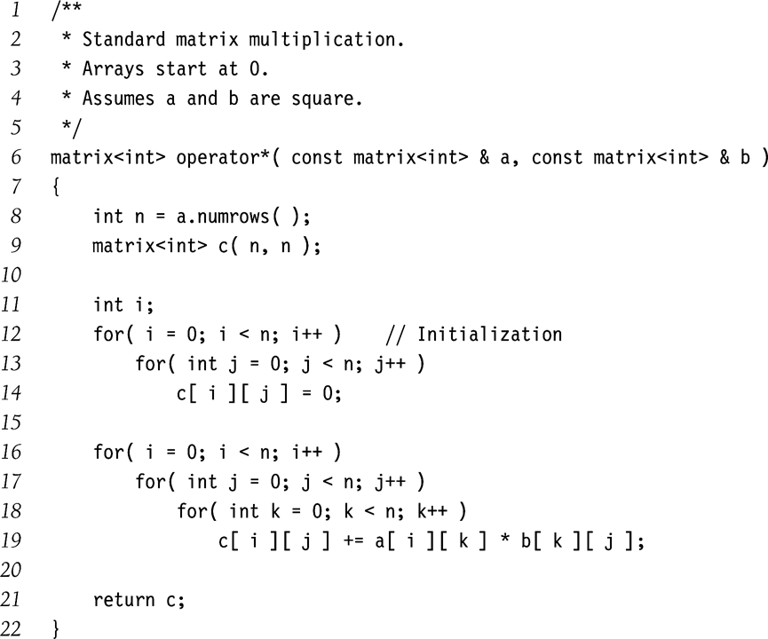
Arithmetic Problems
Matrix Multiplication
Simple O(N³) algorithm to compute C = AB, where A, B, and C are NxN matrices.

Slide 27

Arithmetic Problems
Strassen’s algorithm
Divide each matrix into four quadrants.
Then,
We then perform eight N/2-by-N/2 matrix multiplication and four N/2-by-N/2 matrix additions. Matrix addition takes O(N²), so → No improvement..
Use strategy similar to the integer multiplication algorithm.

Slide 28
Randomized Algorithms
Randomized algorithms
At least once during the algorithm, a random number is used to make a decision.
It has no bad inputs but only bad random numbers.
Consider two variants A and B of quicksort:
A uses the first element as pivot, while B uses a randomly chosen one.
A will run in every time it is given an already-sorted list.
B will give an O(NlogN)-expected-time for any input.
By using a randomized algorithm, the particular input is no longer important.

Slide 29
Random-Number Generators
Random number generation
True randomness is virtually impossible on a computer. It suffices to produce pseudorandom numbers appearing to be random.
What is really needed is a sequence of random numbers.
Linear congruential generator (Lehmer, 1951):
Some value of x₀ (seed) must be given. If M is prime, then x_{i} is never 0. If x₀=0, the sequence is far from random.
If A and M are correctly chosen, any is equally valid.
Ex) 7, 5, 2, 3, 10, 4, 6, 9, 8, 1, 7, 5, 2, …
Sequence has a period of M-1. Some choices of A do not. EX) : 5, 3, 4, 9, 1, 5, 3, 4, …
Lehmer suggested the use of 31-bit prime M = 2³¹ – 1 = 2,147,483,647 For this, A = 48,271 is one that gives a full period generator.
The system clock can be used for the seed.

Slide 30
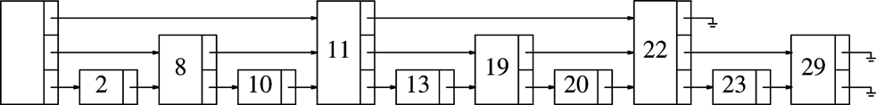
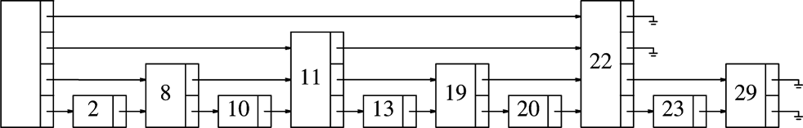
Skip Lists
A data structure that supports both searching and insertion in O(logN)?
The problem is that it is too rigid to allow efficient insertion.
level-k node - node that has k links.
i-th link in any level-k node (k>=i) links to the node with levels ≥ i.
Roughly half are level-1, a quarter are level-2, …, 1/2^{i} are level-i.
nodes examined
in the worst case
nodes examined
in the worst case
nodes examined

Slide 31
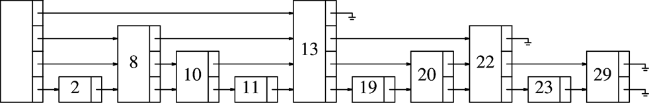
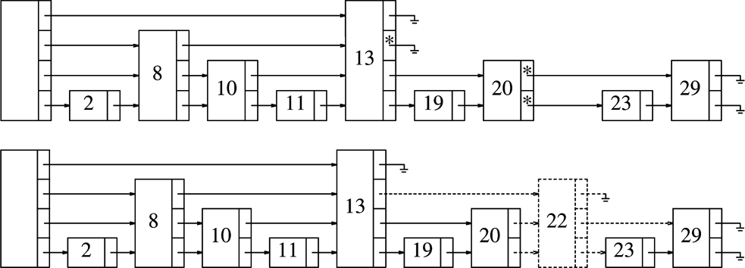
Skip Lists
Search – start at highest link, traverse along the level until we find the next is larger. Then go to the next lower level, … When stopped at level 1, either we are at the node we’re looking for, or it is not in list.
Skip lists
Choose the level randomly, in accordance with the prob. distribution.
Flip a coin until a head occurs. Total # flips as the node level.
Insert
Since # nodes at each level is unchanged from the nonrandomized algorithm, the expected work for traverse is unchanged. → O(logN) expected costs.

Slide 32
Backtracking Algorithms
A clever implementation of exhaustive search
Example: the problem of arranging furniture
If all the furniture is placed and the owner is happy, it terminates.
If we reach a point where all subsequent placement is undesirable, we have to undo the last step and try an alternative. It might force another undo, … - backtracking
If we undo all possible first steps, there is no placement satisfactory.
Different from brute force. Backtracking does not try all possibilities.
Man bad arrangements (such as placing sofa in the kitchen) are discarded because an undesirable subset of arrangement is detected.
Pruning – the elimination of a large group of possibilities in one step.

Slide 33
Turnpike Reconstruction Problem
N points p₁, p₂, …, p_{N} are located on the x-axis. x_{i} is the x coordinate.
Distances d₁, d₂, …, d_{N} between every pair of points determined.
Turnpike reconstruction problem
is to reconstruct a point set from the distances.
Many applications in physics and molecular biology
No polynomial time algorithm. The algorithm given here runs in O(N²logN) generally but takes exponential time in the worst case.
Ex: distance set D = {1, 2, 2, 2, 3, 3, 3, 4, 5, 5, 5, 6, 7, 8, 10}
From |D|= 15 = N(N-1)/2, we know that N=6.
Set x₁ = 0 and x₆ = 10. We remove 10 from D.
x₁=0
x₆=10
D = {1, 2, 2, 2, 3, 3, 3, 4, 5, 5, 5, 6, 7, 8}

Slide 34
Turnpike Reconstruction Problem
The largest remaining distance is 8, meaning either x₂=2 or x₅=8. By symmetric, choice is unimportant. Set x₅=8. Remove x₆-x₅=2, x₅-x₁=8 from D.
7 is the largest in D, either x₄=7 or x₂=3. For x₄=7, x₆-7=3 and x₅-7=1 must be present in D (Indeed they are). For x₂=3, 3-x₁=3 and x₅-3=5 must be in D (Yes). We try one and see if it leads to a solution. If not, we come back and try the other.
Set x4=7
Now the largest distance is 6, so x₃=6 or x₂=4. But if x₃=6, x₄-x₃=1 and x₅-x₂=4 (Impossible). If x₂=4, x₂-x₀=4 and x₅-x₂=4 (Impossible). → x₄=7 failed.
x₁=0
D = {1, 2, 2, 3, 3, 3, 4, 5, 5, 5, 6, 7}
x₅=8
x₆=10
x₁=0
D = {2, 2, 3, 3, 4, 5, 5, 5, 6}
x₄=7
x₅=8
x₆=10

Slide 35
Turnpike Reconstruction Problem
Try x₂=3.
We have to choose x₄=6 and x₃=4. x₃=4 is impossible.
x₄=6
x₃=5. We have a solution!
x₁=0
x₂=3
x₅=8
x₆=10
D = {1, 2, 2, 3, 3, 4, 5, 5}
x₁=0
x₂=3
x₄=6
x₅=8
x₆=10
D = {1, 2, 3, 5, 5}
x₁=0
x₂=3
x₃=5
x₄=6
x₅=8
x₆=10
D = { }

Slide 36
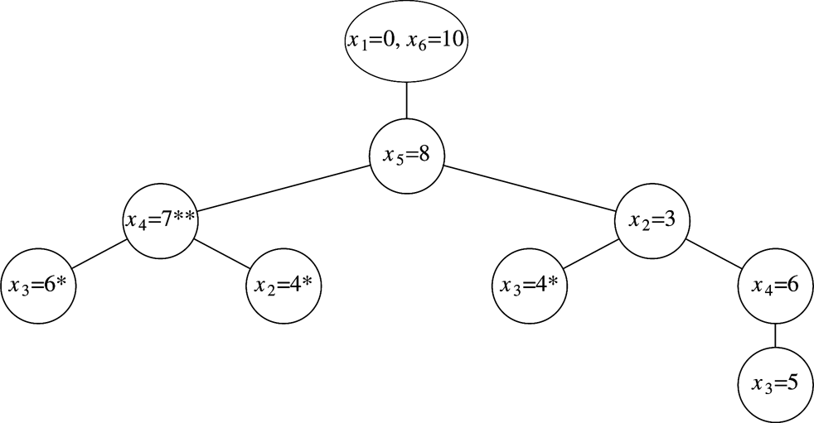
Turnpike Reconstruction Problem
The decision tree representing the actions taken to arrive the solution.
Node with a asterisk (*): points chosen are inconsistent with the given distances.
Node with two asterisks (**): have only impossible nodes as children, representing an incorrect path.

